Slide 1



Slide 2
Autonomous System

Slide 3
RULES
  No side talks
  Phones are in silent mode
  Questions after each slide
  Take permission before leaving
  There will be a break during the session if you want to eat or drink
  Make sure to take notes about what is discussed

Slide 4
Session 5
“Motion planning”

Slide 5
About the instructor
Name : Zaynab Ahmad
Mechatronics lvl 200
Autonomous committee Member 2023

Slide 6
Introduction to planning
Why motion planning
Challenges in motion planning
Basic concepts
1- c- configuration space
2- state space
3- degree of freedom (DOF)
4- path vs trajectory
Types of motion planning
Recap on occupancy grid map and graph
Algorithms used in each type motion planning
Agenda

Slide 7

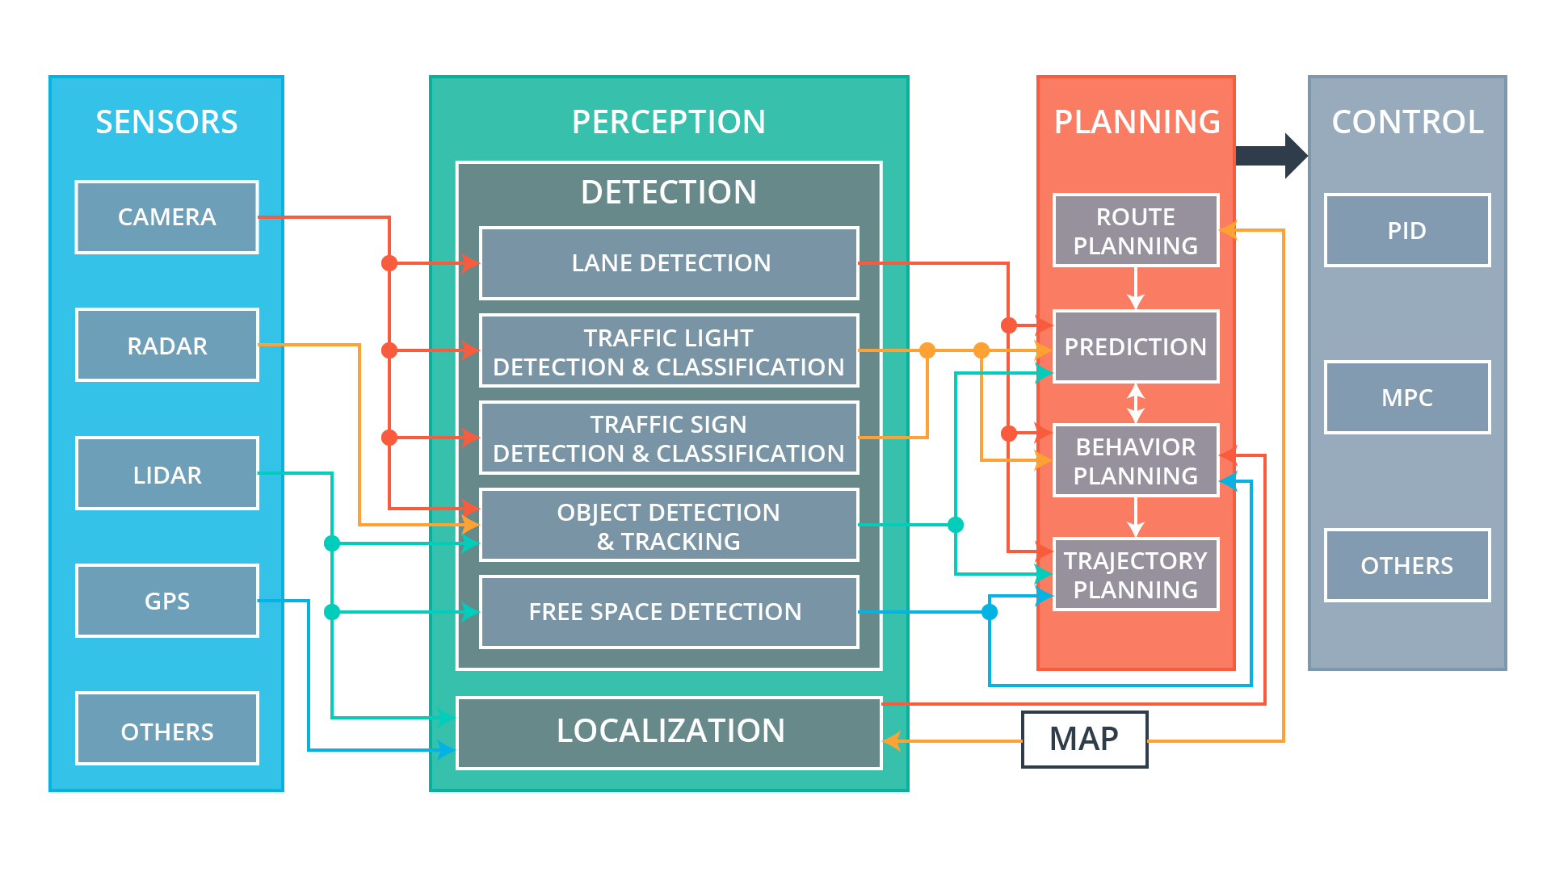

Slide 8
Motion planning
Getting to the location, getting by any obstacles, following any rules

Slide 9
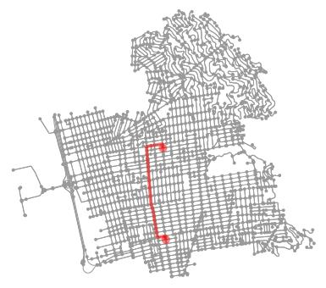
Motion planning
Navigating from S to G on the map
Low-level details are abstracted away
Ensure safe navigation by avoiding obstacles
Allows adaptation to dynamic and changing environments
The goal is to find the most efficient path (in terms of time and distance)

Slide 10
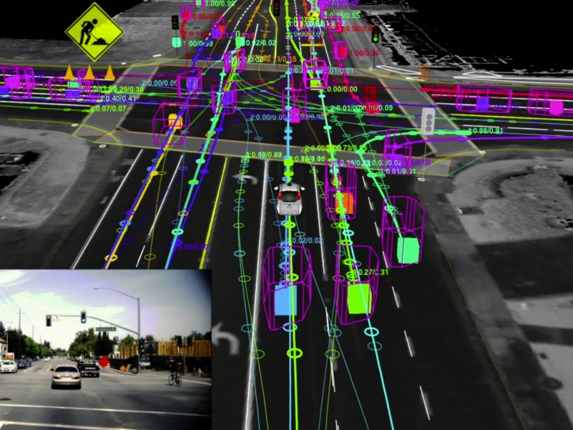
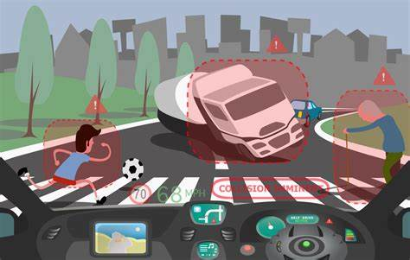
Motion planning challenges
Complex environment
urban settings with traffic , pedestrians ,cyclists , and diverse road conditions
Real-time decision making
respond to rapidly changing situations
delays or inefficient planning can effect safety and smooth operation

Slide 11
Motion planning challenges
Uncertainty and prediction
Optimality VS. Real time efficiency
Legal and ethical considerations
Sensor limitations
Human – robot interaction

Slide 12

Basic concepts
C-configuration space
State space
Degree of freedom
Path VS trajectory

Slide 13
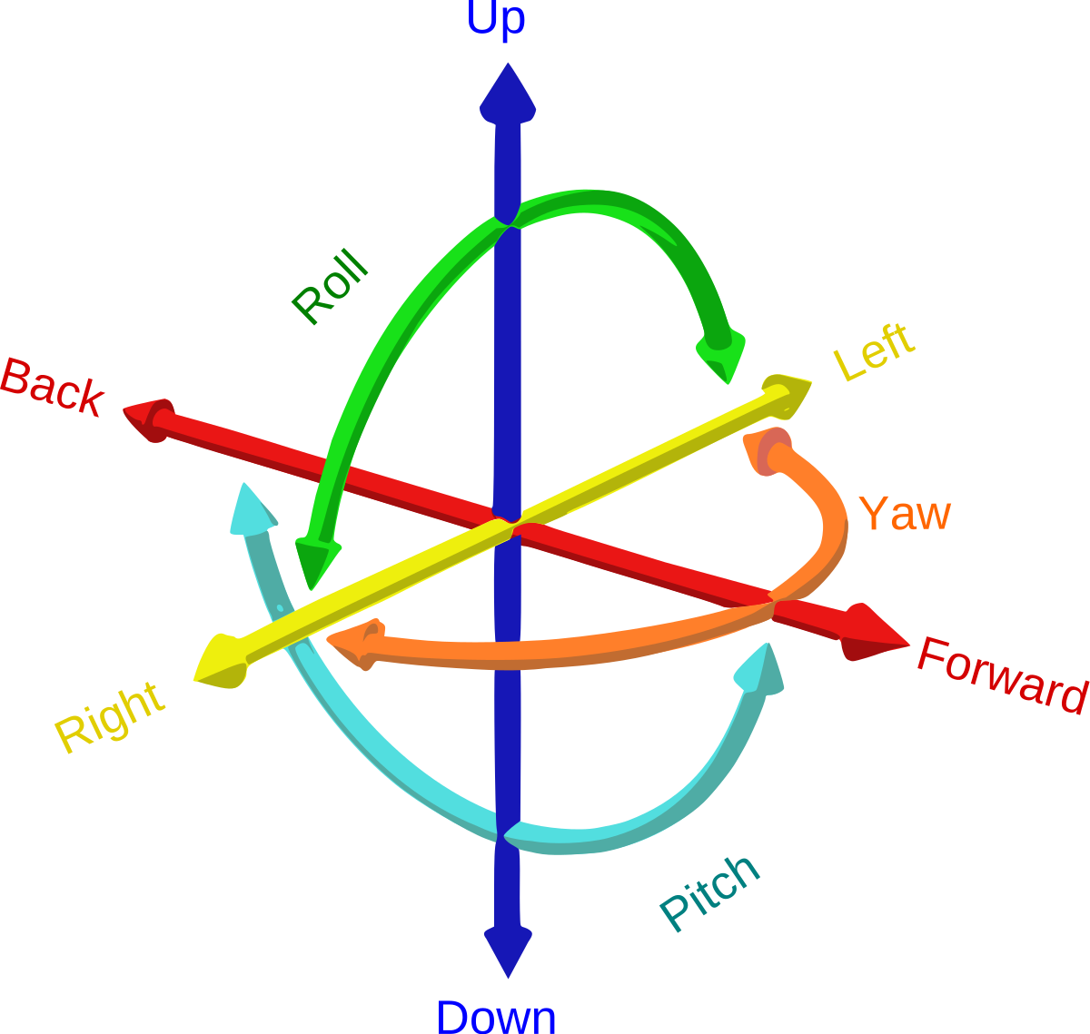
Basic concepts:
Degree of freedom (DOF)
Numbers of independent parameters or variables required to fully describe the configuration or state of the system

Slide 14
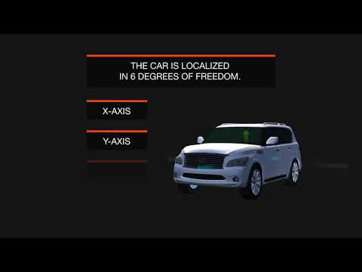
Basic concepts:
Degree of freedom (DOF)

Slide 15
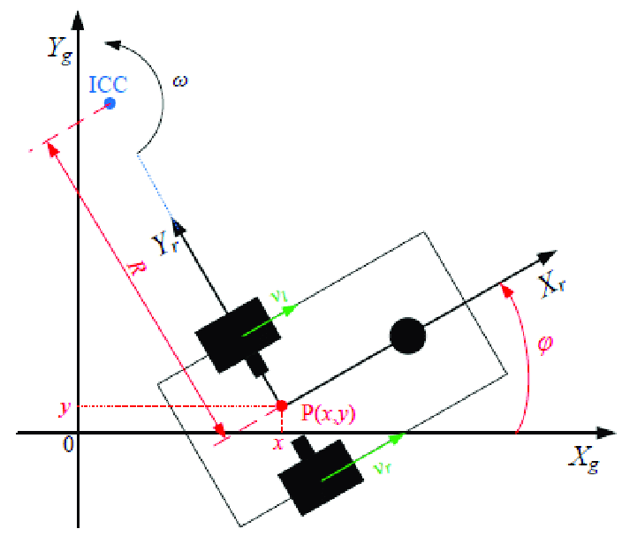
Basic concepts:
State space
A mathematical representation that describes all complete set of possible states or configurations of a system at a specific moment

Slide 16
Basic concepts: Configuration space
A mathematical abstraction that represents all possible configurations or states that a system, such as a self-driving car can take, considering its degrees of freedom and constraints

Slide 17
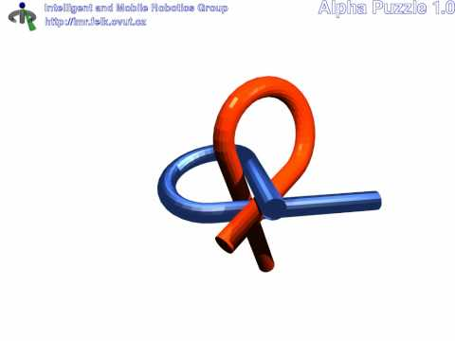

Slide 18
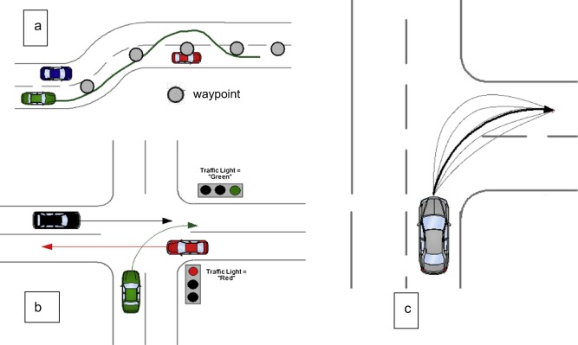
Path VS trajectory
Path
a path represents a series of connected points in space that describe the desired route from the initial to the final position
Focus on geometry and do not include time or velocity data
useful for high-level planning, providing a general route to follow

Slide 19
Path VS trajectory
Trajectory
a trajectory extends the concepts of a path by adding time and velocity information to each point, resulting in a dynamic sequence of states
Specify not only where the system should be but also how it should get there at what speed
ensuring smooth and precise motion execution

Slide 20
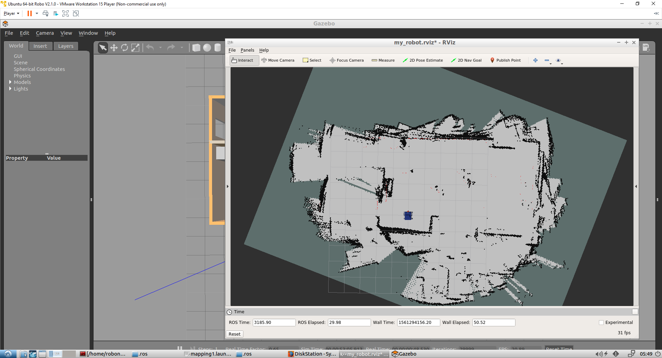
Recap on occupancy grid
Is a 2D representation of the environment
It is very similar to the grayscale image
Occupancy probability
Assumptions
1- static environment
2- independent cells
3- a place can be either occupied or free

Slide 21
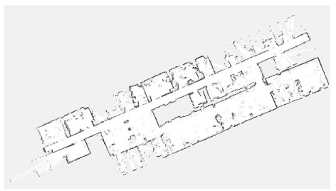
Recap on occupancy grid

Slide 22
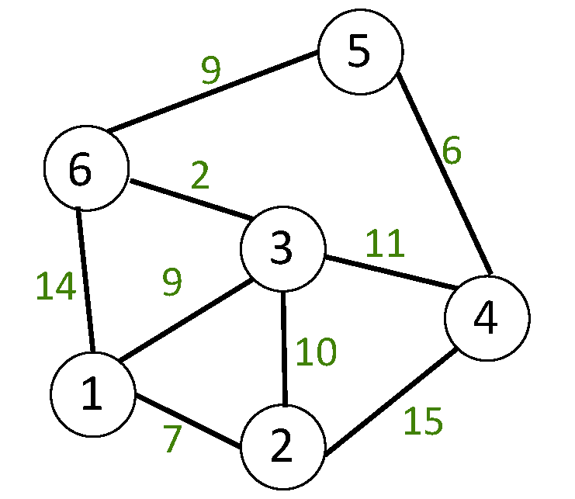
Recap on graph
Concepts
Directed VS undirected graphs
Weighted graphs
Configuration space graphs
Graph search algorithms
Optimally VS completeness

Slide 23
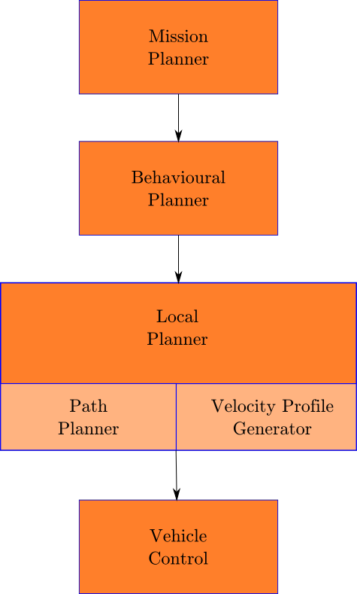
Types of motion planning
Motion planning broke into hierarchy of some problems
Mission planners focuses on mop-level navigation
Behavioral planning focuses on other agents, rules of the road , driving behaviors
Local planner focuses on generating feasible, collision-free path

Slide 24
Mission planner(route selection)
Mission planners focuses on mop-level navigation
can be solved with graph-based methods (A*, Dijkstra's)

Slide 25
Mission planner –Dijkstra's
Works on both directed and undirected graphs
Single source shortest path (SSSP)
Non-negative edge weights
Uses cost function(g(n))
Time complexity: O(E*log(v))
Steps :
1- update estimates
2- choose the next vertex
Pseudo-code
For each vertex V :
Dist[V]=∞
prev[V]=none
Dist[source]=0
Set all vertices to unexplored
While destination is not explored :
V = least_valued unexplored vertex
set V to explored
For each edge (V,W):
If dist[V]+len(V,W)<dist[W]:
Dist[W] =Dist[V]+len(V,W)
prev[W]=V

Slide 26
Mission planner –A*
Works on both directed and undirected graphs
Single source shortest path (SSSP)
Non-negative edge weights
Uses cost function (g(n)) and heuristic (h(n))
Time complexity: O(E*log(v))
Steps :
1- update estimates
2- choose the next vertex
Pseudo-code
For each vertex V:
dist[V] = ∞ # Cost
prev[V] = none
heuristic[V] = heuristic_estimate(V, goal) # Heuristic
dist[source] = 0
Set all vertices to unexplored
While destination is not explored:
V = unexplored vertex with the lowest dist[V] + heuristic[V] value
Set V to explored
For each edge (V, W):
tentative_dist = dist[V] + len(V, W)
if tentative_dist < dist[W]:
dist[W] = tentative_dist
prev[W] = V

Slide 27
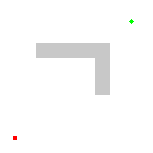
Mission planner –optimization of algorithms
A* optimization with epsilon
A* algo

Slide 28
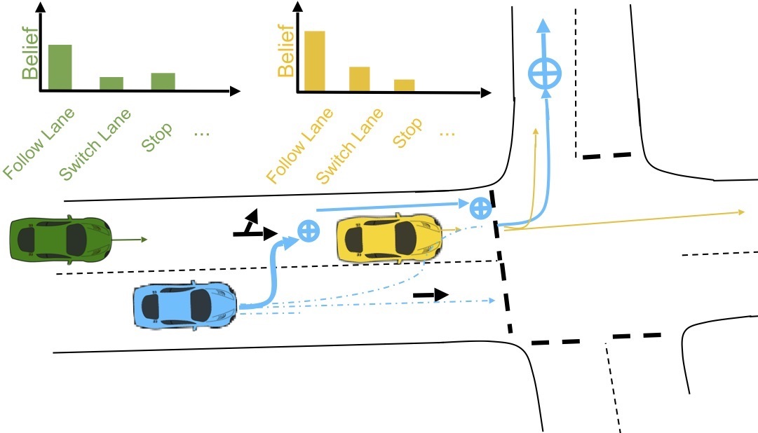
Behavior planner
The behavior planner decides when it is safe to proceed
Takes pedestrians, vehicles, cyclists into consideration
Also looks at regulatory elements, such as traffic lights and stop signs

Slide 29
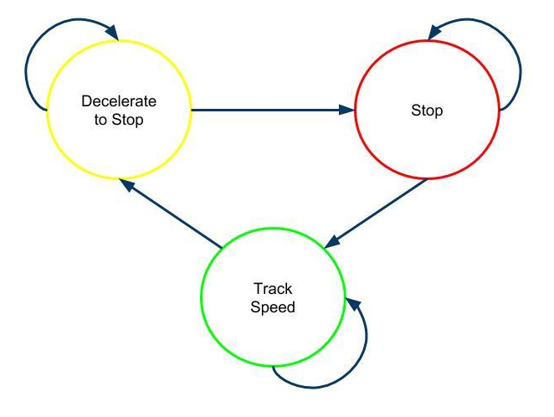
Behavioral planner -Finite state machines
Composed of states and transitions
    States are based on perception of surroundings
    Transitions are based on inputs from the driving scenario eg, stop lights changing color
FSM is memoryless
  Transition only depend on input and current state, and not past state sequence

Slide 30
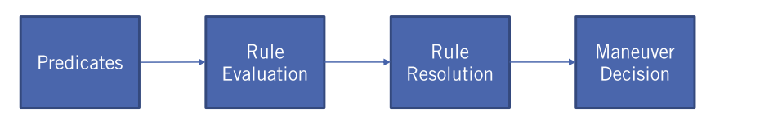
Behavioral planner –rule based
Rule based system use a hierarchy of rules to determine output behavior
Rules are evaluated based on logical predicates
Higher priority rules have precedence

Slide 31
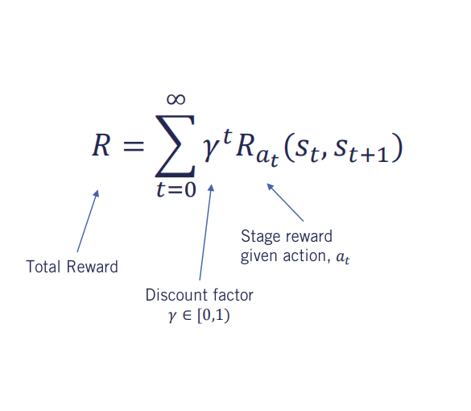
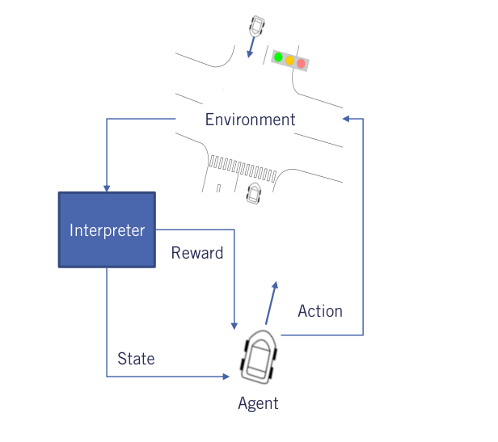
Behavioral planner –Reindorsement learning

Slide 32
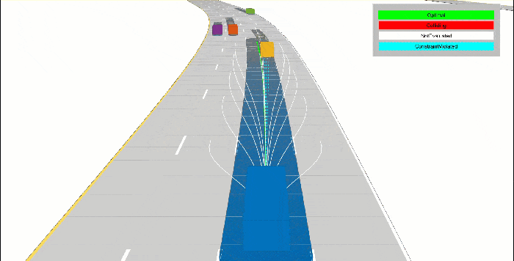
Local planner
Local planning focuses on generating feasible, collision-free paths and comfortable velocity profiles
Decomposed into path planning and velocity profile generation

Slide 33
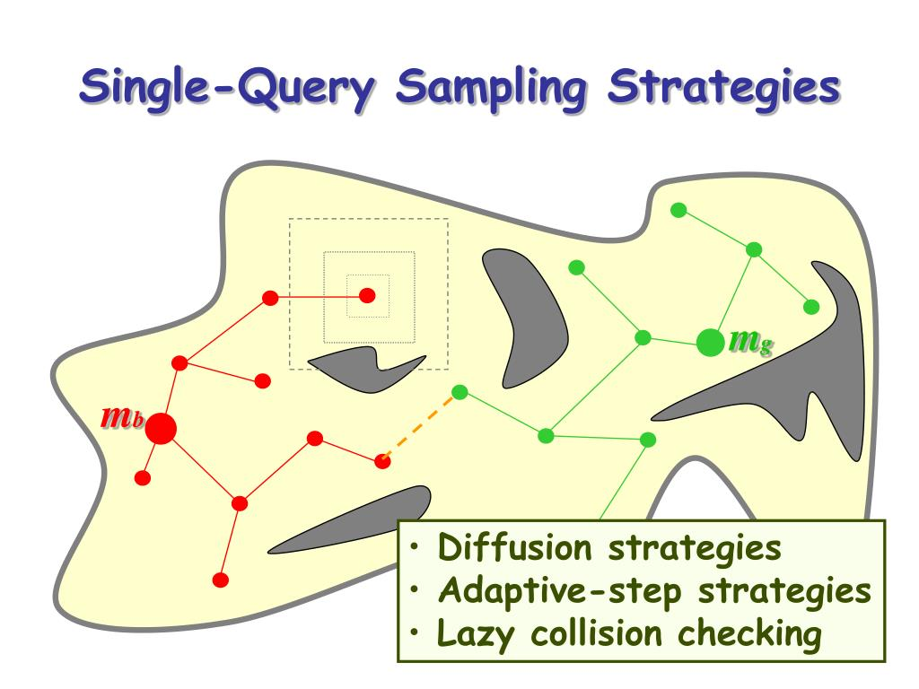
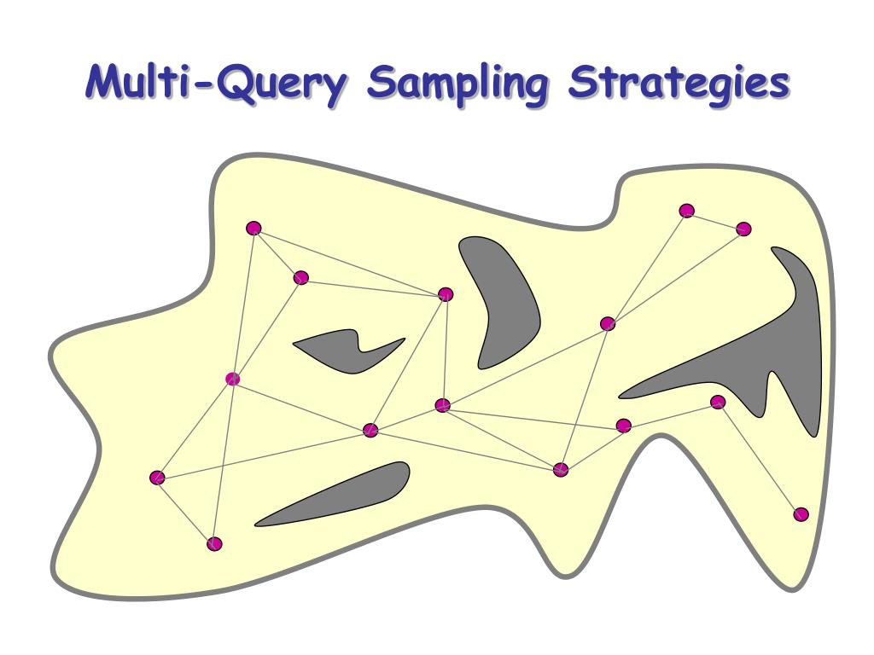
Sampling based
Rapidly exploring the state space to find feasible trajectories.
Handling dynamic environments and real-time decision-making
There are two approaches (single-query and multiple-Query)
Balancing exploration (finding new paths) and exploitation (refining known paths).

Slide 34

RRT

Slide 35
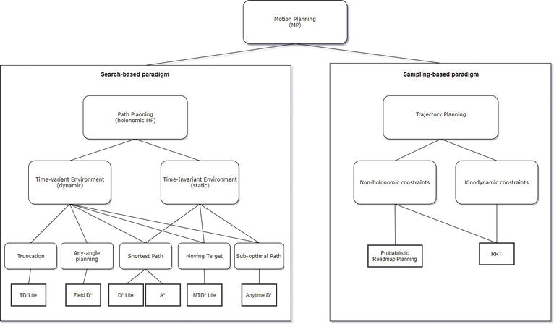

Slide 36

Thank You

